Slide 1
Transpennine Route Upgrade
Programme overview

Slide 2
TRU Improvements
Electrifying the whole route between Manchester and York via Huddersfield and Leeds
Installing a new digital signalling system
Doubling the number
of tracks from two to four between Huddersfield
and Westtown (Dewsbury)
Improving stations
(including better
accessibility) ​
Improving the railway on diversionary routes

Slide 3
TRU benefits
More trains to choose from and more seats
More reliable journeys
Faster journeys
Better stations
Greener travel
Our improvements will enable more trains to run between Manchester, Leeds and York
Up to six fast/semi-fast services every hour between Leeds and Manchester and up to two stopping services for local connectivity.
Travel to your favourite towns and cities more quickly.
Our fastest journey times are forecast to be 63-66 minutes between Manchester and York and 41-42 minutes between Manchester and Leeds.
Smoother journeys with trains that run on-time.
Station improvements across the Transpennine route, bringing passengers
a better travel experience through improved, more accessible stations
Reducing our carbon footprint and improving air quality.
We’re also developing a proposal to move more goods by rail (up to 15 more freight trains) removing over 1,000 lorries off the road each day.

Slide 4
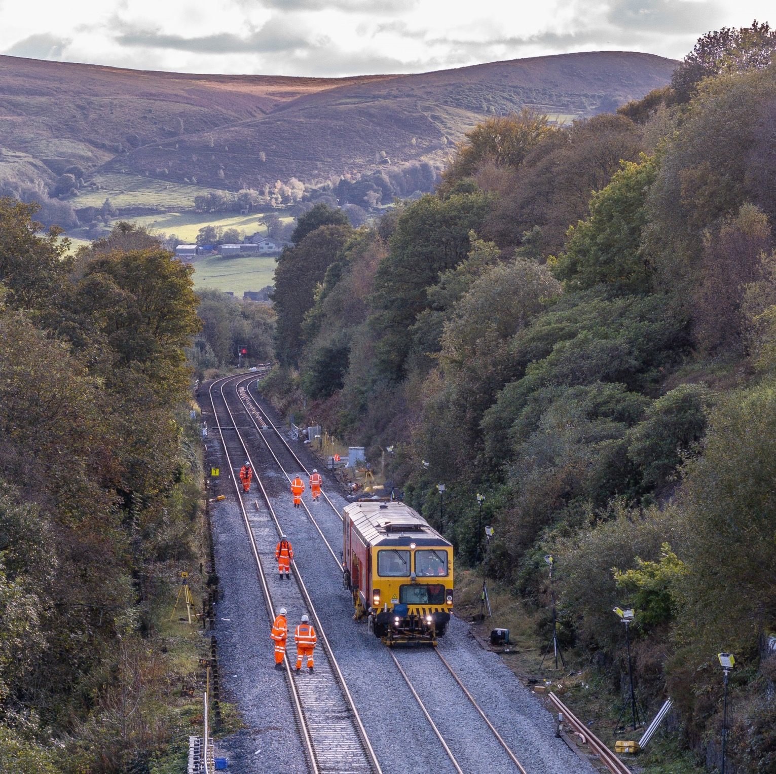
Project Overview

Slide 5
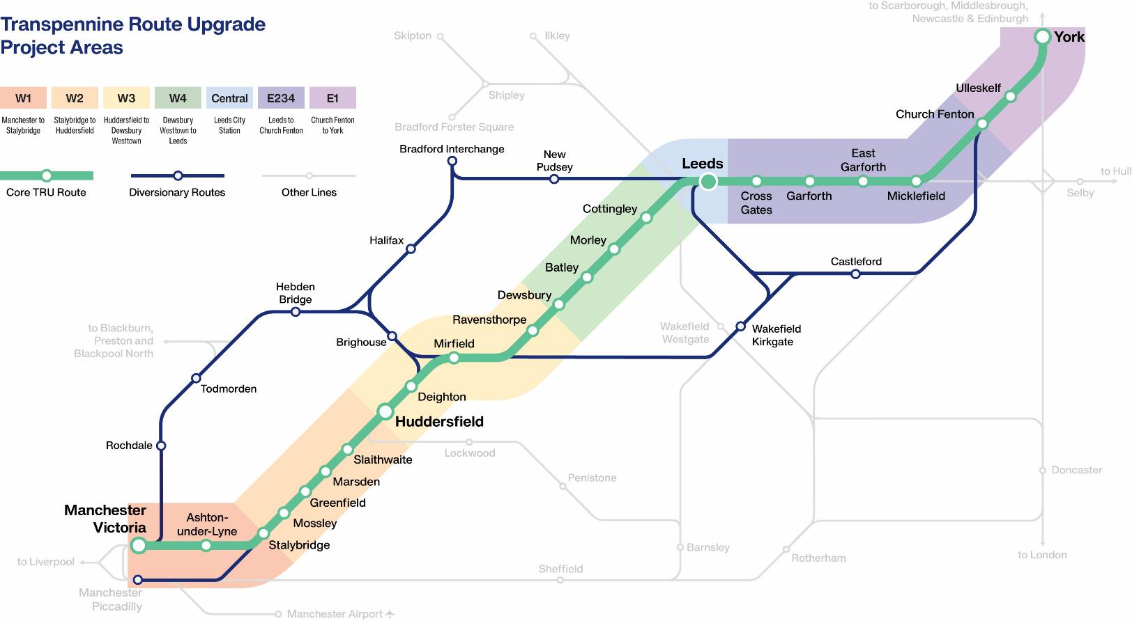
TRU route
Transpennine Route Upgrade
Project Areas
70
Miles of track
23
Stations
29
Level crossings
6
Miles of tunnels
3
Miles of viaducts

Slide 6
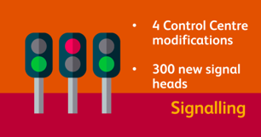
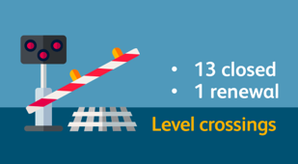
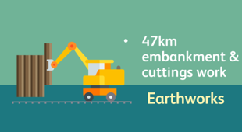
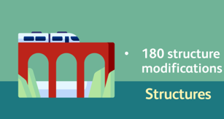
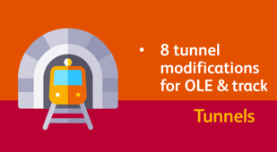
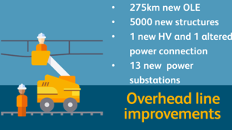
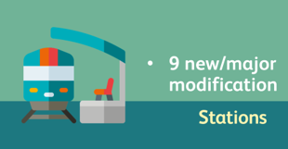
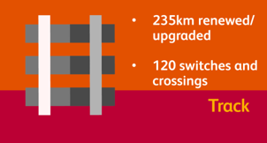
TRU in numbers

Slide 7
TRU being more sustainable
Carbon and climate change
Biodiversity and environmental impact
Carbon reduction during design and construction
Weather resilience and climate change risk assessments used to inform design and construction
10% biodiversity net gain, replacing and enhancing habitats and ecological features that we impact
Zero waste to landfill with
90% reuse and recycling
100% sustainably sourced timber

Slide 8
Programme Timeline
Projects in delivery, Programme working towards PBC2
Planned Key Output 2 completion
Planned Key Output 3 completion
Key Output 1 completion
Business Case Updates
Completion of W3, W4, W5, E234
Completion of core TRU Programme
TRU benefits fully realised
ETCS
Early 2020s
Late 2020s
Early 2030s
Late 2030s/early 2040s

Slide 9
Project maturity
Development | Design | Construction | Completion
E1 – Church Fenton to York
W1 – Manchester to Stalybridge
W2A – Stalybridge
E234 – Leeds to Church Fenton
W2B – Stalybridge to Marsden
W3 – Huddersfield to Ravensthorpe
W4 – Ravensthorpe to Leeds
ETCS – Digital Signalling
NPR Facilitation – Digital Signalling
NPR Facilitation – East of Leeds
NPR Facilitation – Marsden to Huddersfield
NPR Facilitation – West of Leeds (other)

Slide 10
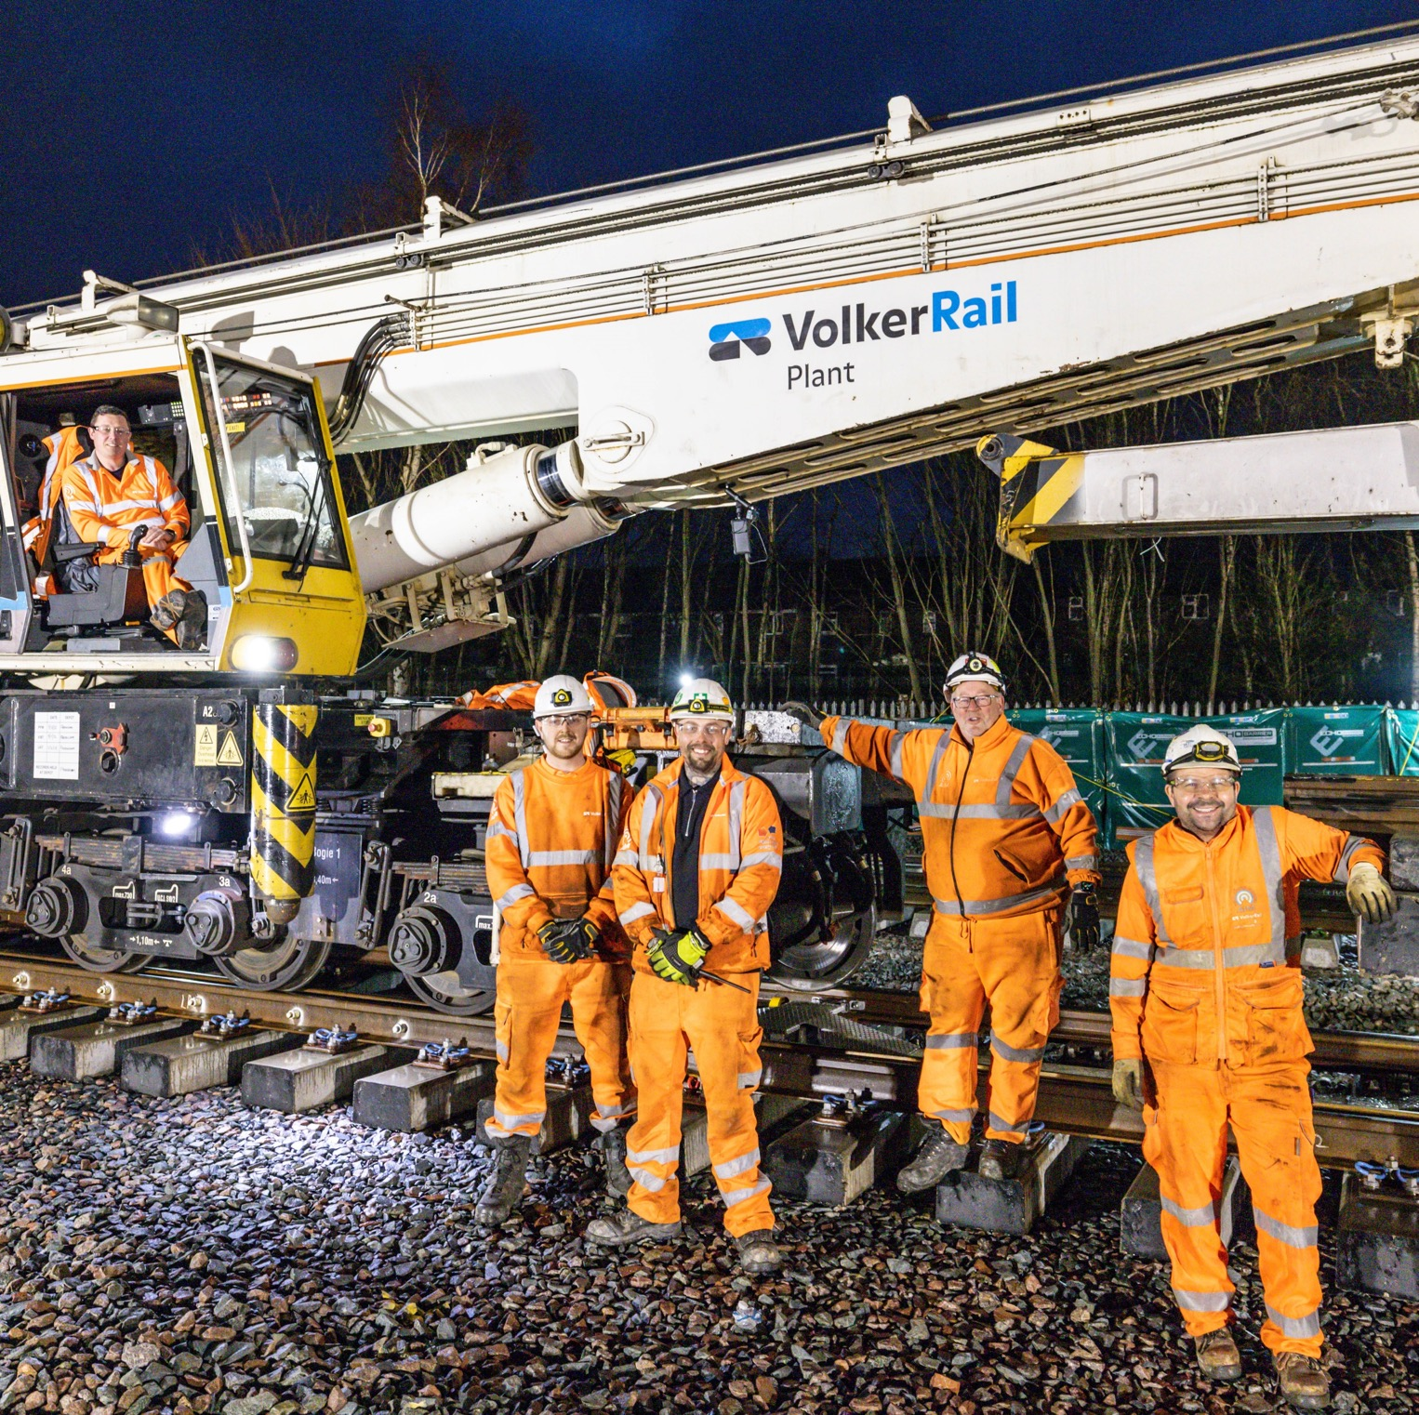
Delivery

Slide 11
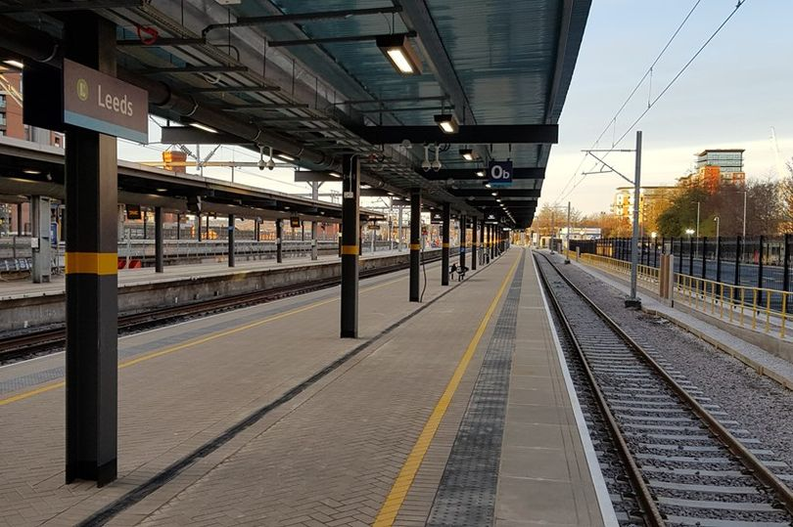
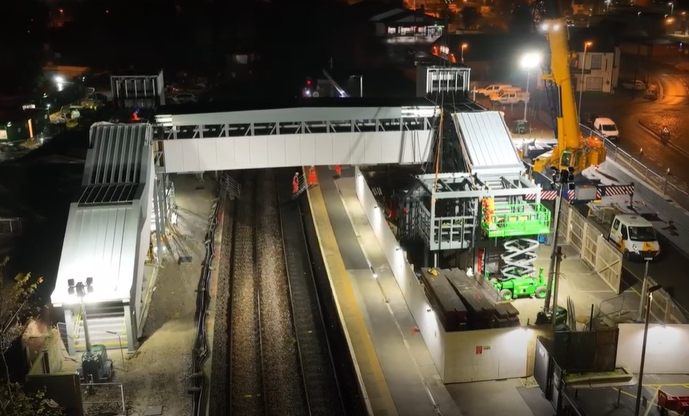
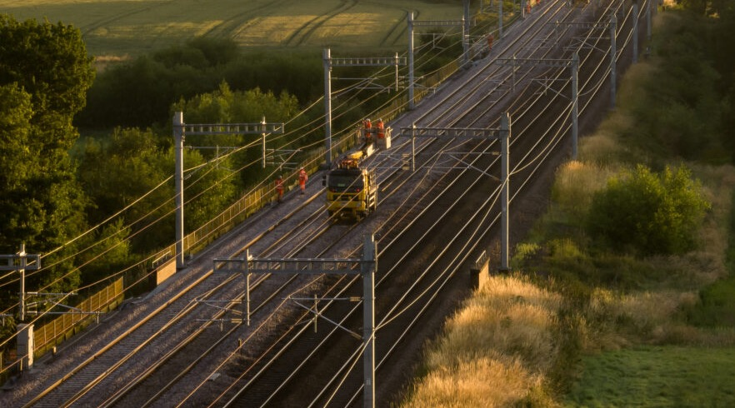
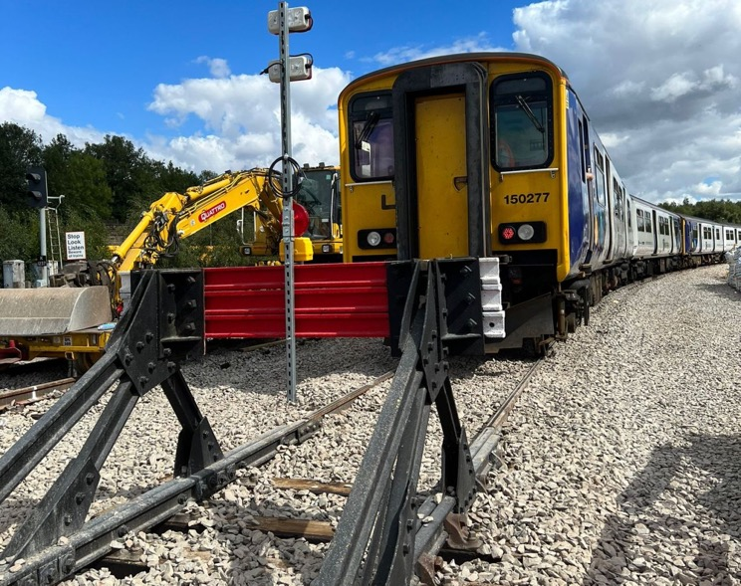
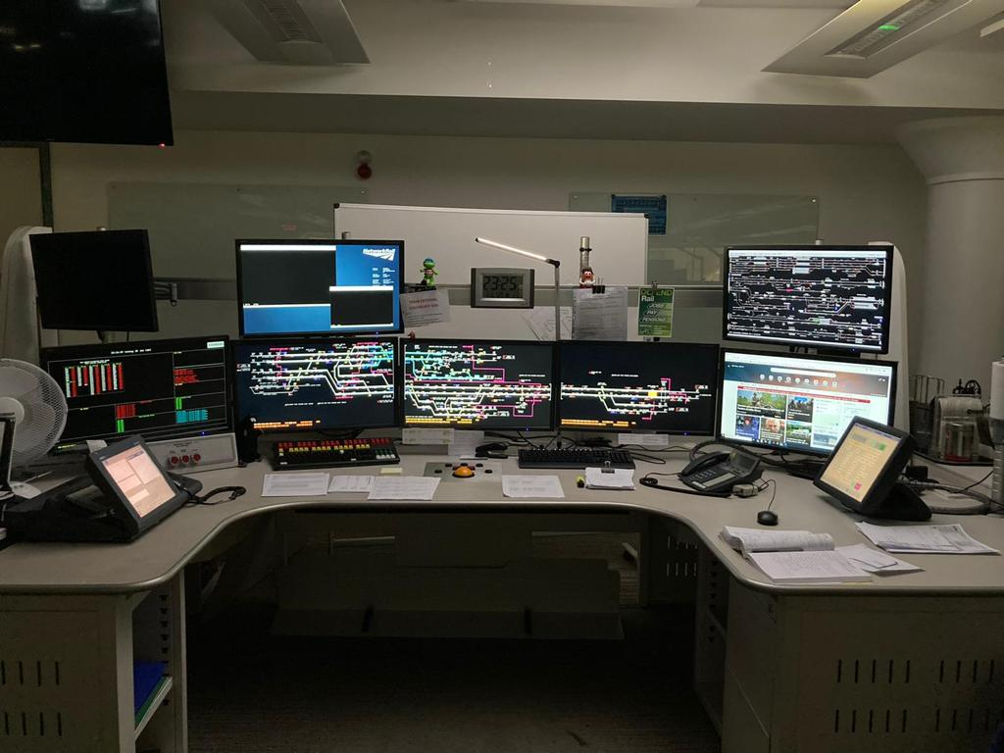
Achievements
Leeds Platform Zero
Castleford
Church Fenton - Colton Junction
COBRA Sidings
Manchester to Baguley Fold Signalling Upgrade

Slide 12
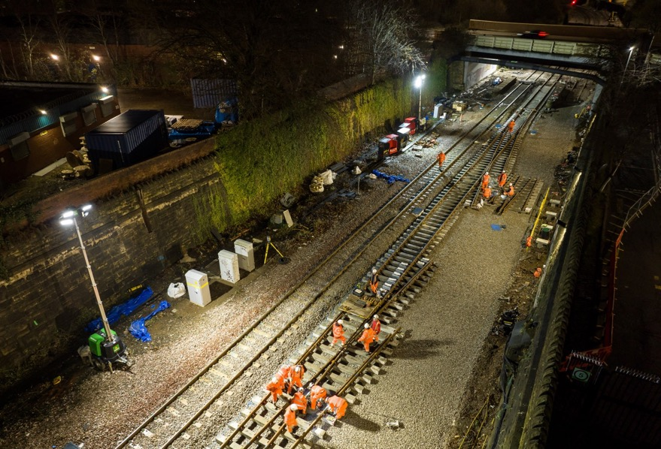
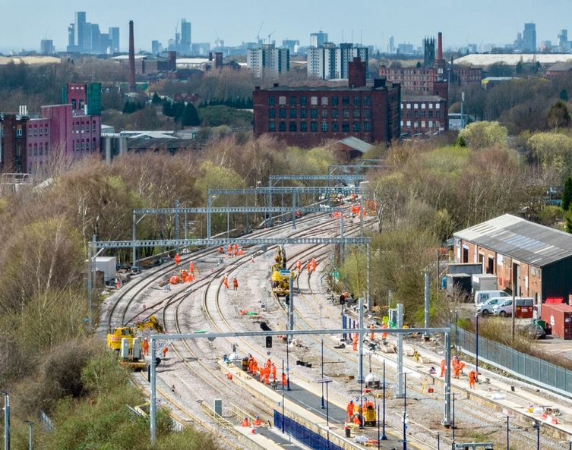
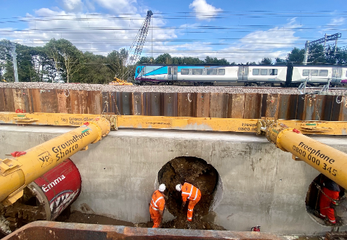
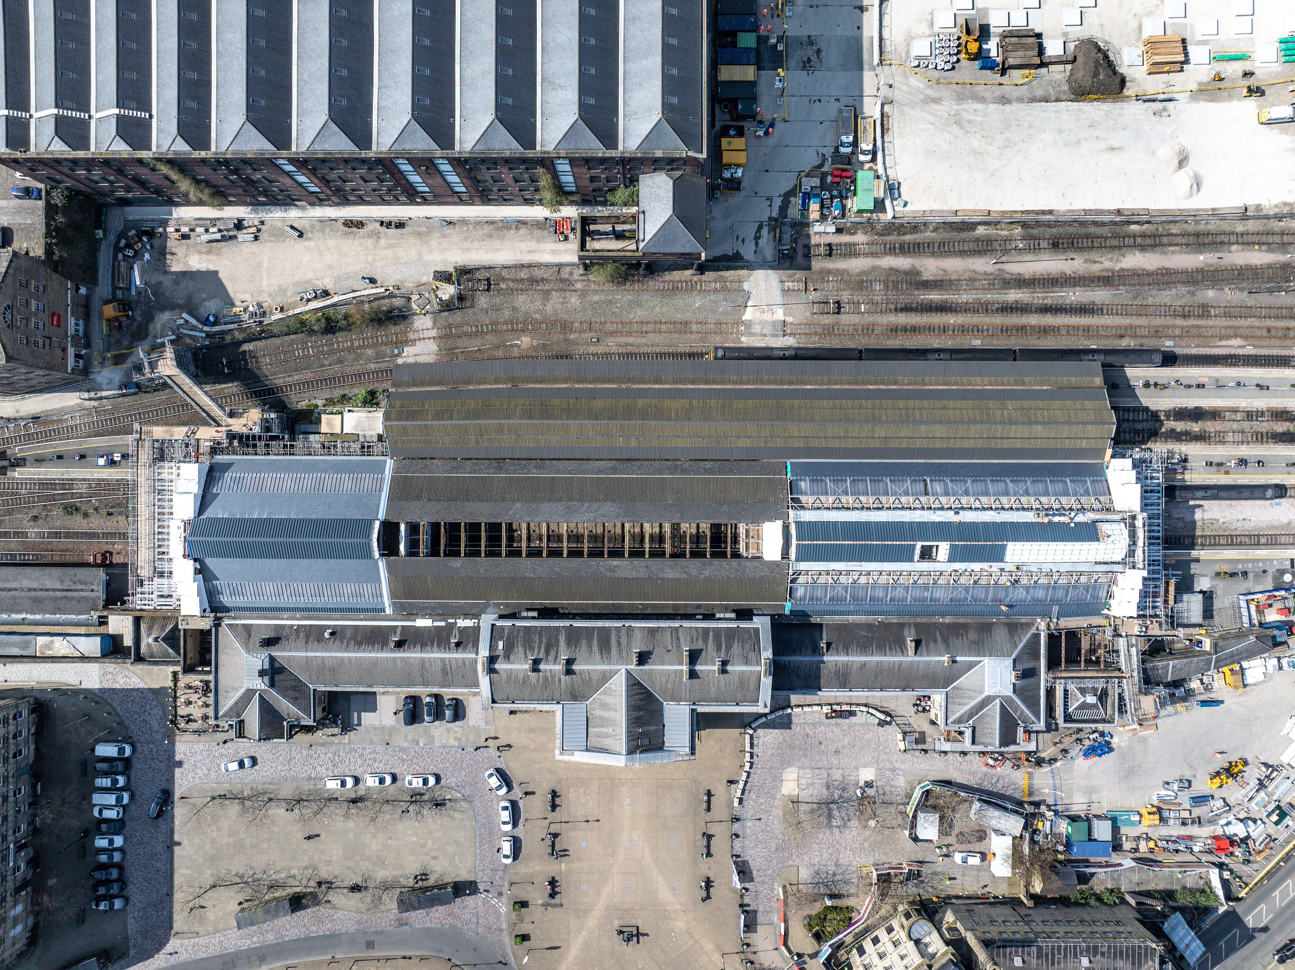
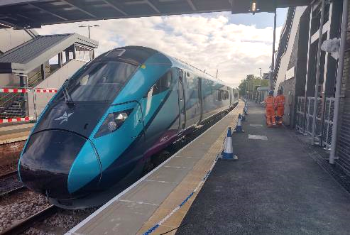
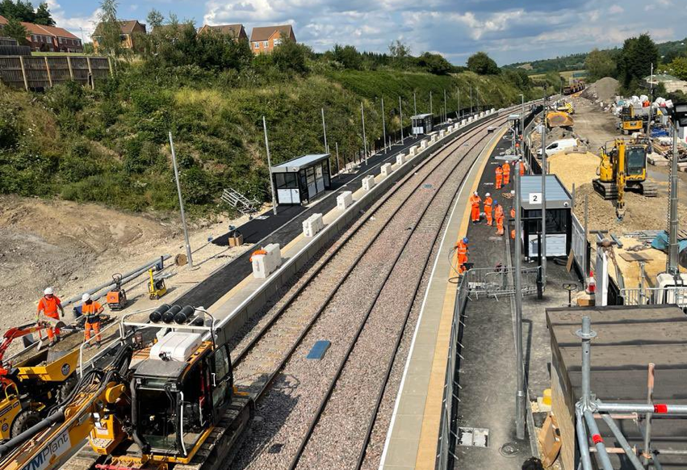
Achievements
Holbeck
Electric trains now running between Manchester and Stalybridge
Ulleskelf Mires triple tunnel installation
Huddersfield station roof canopy
Fully accessible second platform at Castleford
Morley Station

Slide 13
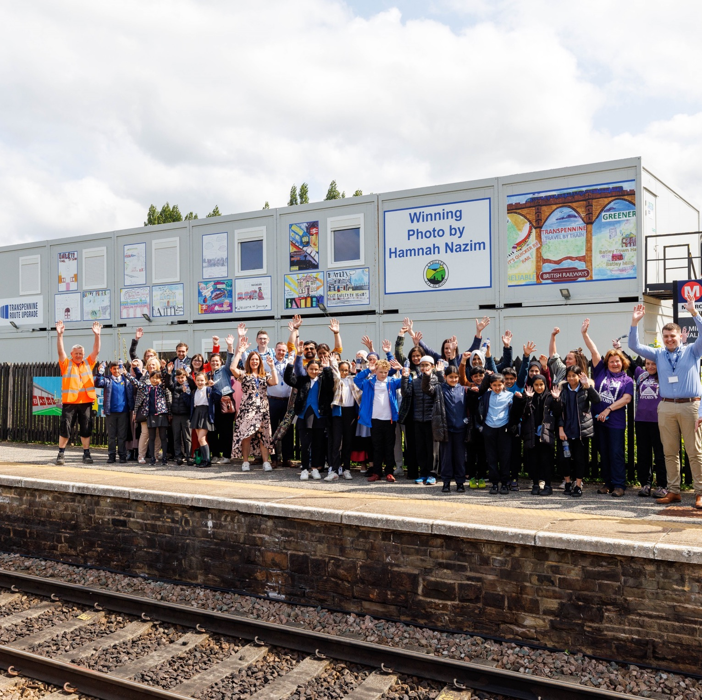
Social Value

Slide 14
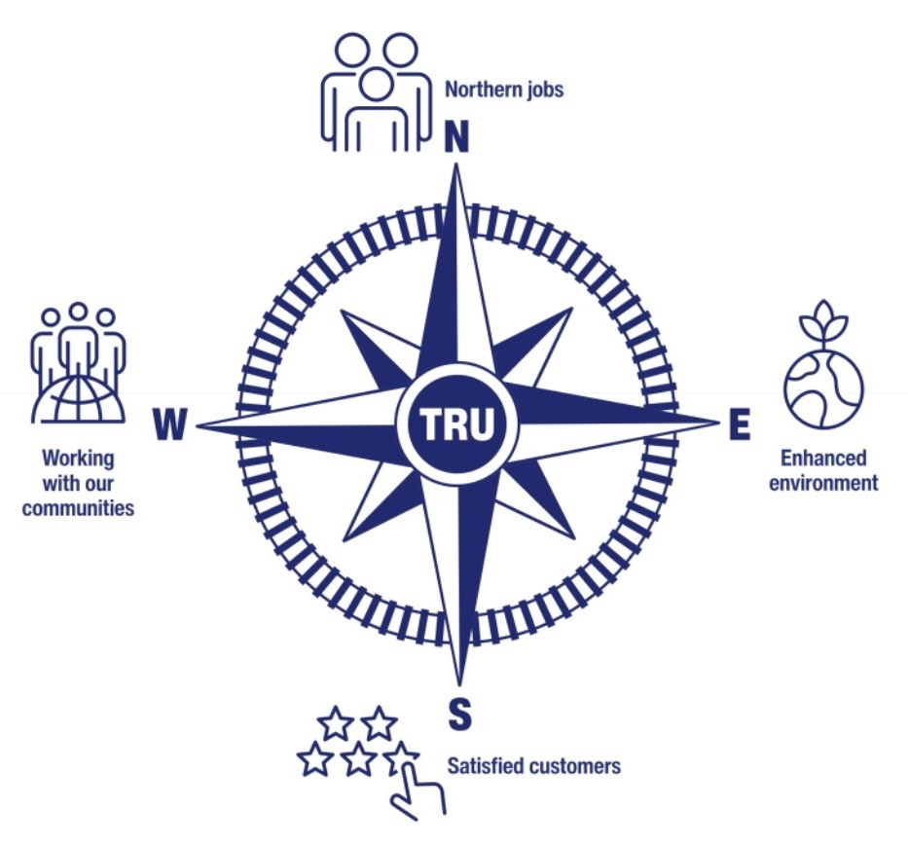
Sustainable development strategy ‘Our Guiding Compass’
We launched our ambitious, cross-industry sustainable development strategy in May 2023 – Our Guiding Compass.
This aims to slash carbon, create thousands of jobs, generate billions of pounds in social value and give back to communities along the route.
The targets include £4.9bn delivered in wellbeing & £4.3bn in social value.

Slide 15
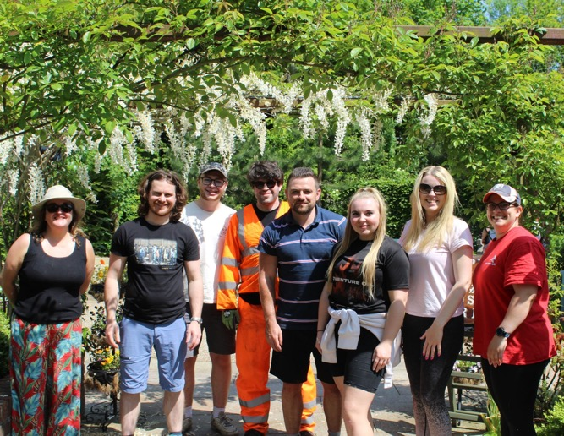
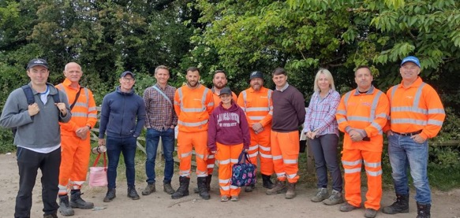
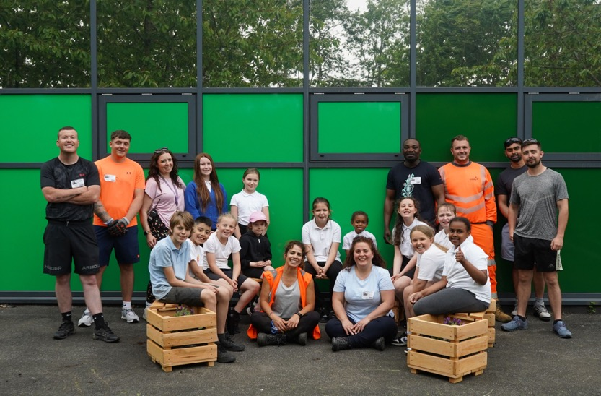
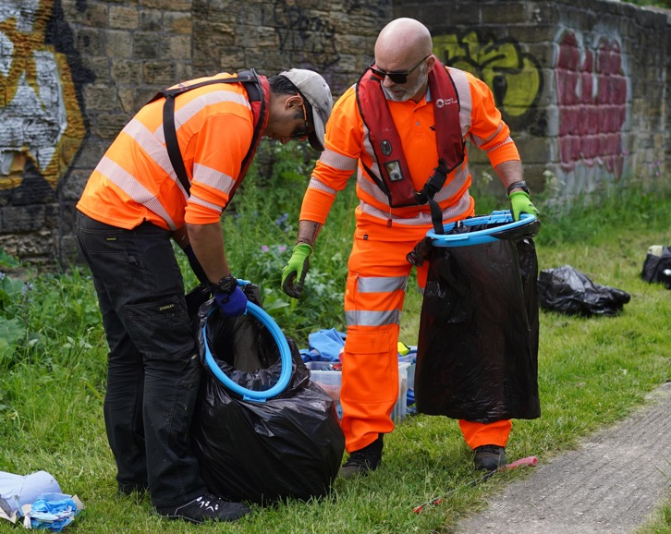
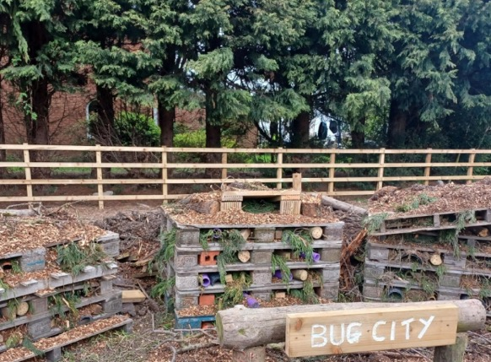
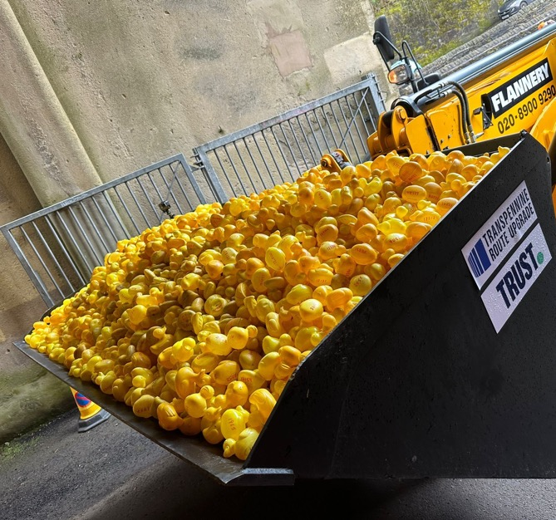
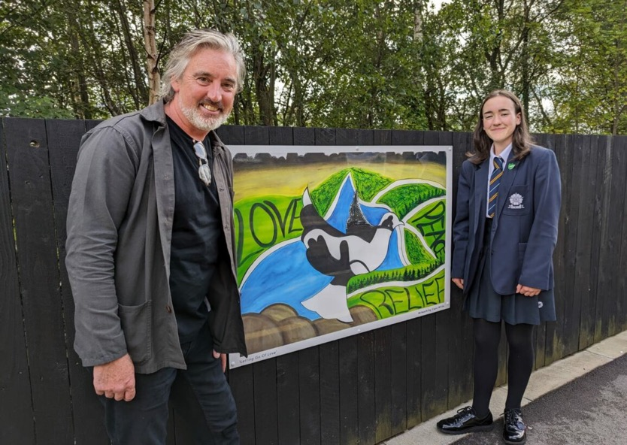
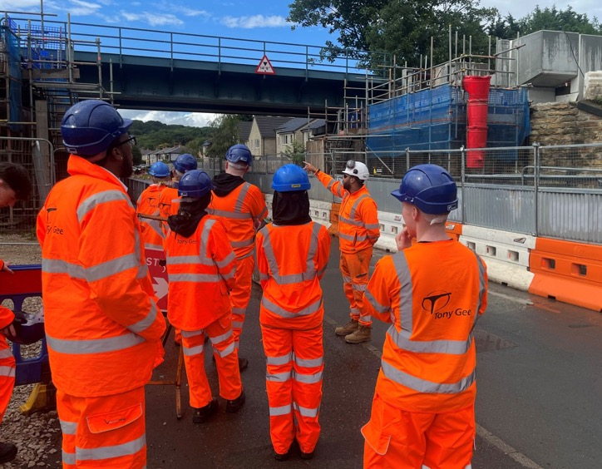
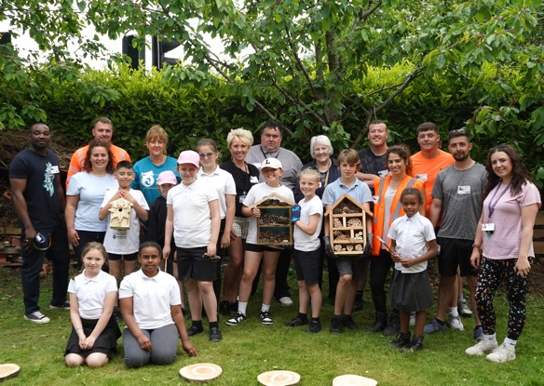
Social Value

